Slide 1


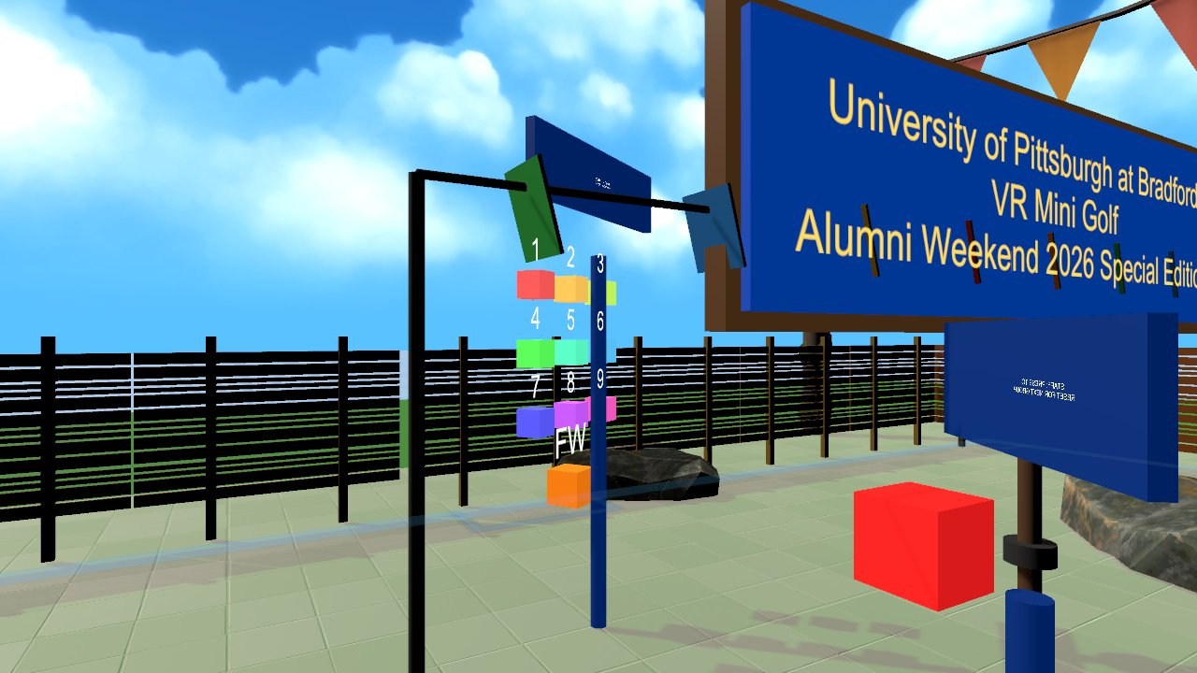

Virtual Reality
Testing and polishing: playtests, automated tests, performance, UX
Wednesdays at 6:00pm
CIST 1423 - 2010 VIRTUAL REALITY PROGRAMMING AND TECHNOLOGY
Lab: playtest your peers' prototypes and give structured feedback (Google Forms)

Slide 2



Agenda
Playtesting
Automated tests
Polish
Tasks, think-aloud, a feedback form
What GolfVR and WaterWorks test
Performance and the last 10%

Slide 3

Today
By the end of class you can…
Run a playtest: brief, task, observe, form, fix
Tonight's plan
1
0–10
Review
Explain what automated tests can and can't cover in VR
2
10–40
Playtesting + automated tests + polish
40–50
Lab briefing
Polish performance, feedback, recoverability and wording
3
50–130
Lab: playtest 3 peers, fill in forms
130–145
Share-out
145–150
Exit ticket
CIST 1423 — Week 14 — Testing & Polishing

Slide 4

How to run a playtest
You learn the most in the first 60 seconds a stranger holds your controllers.
1. Brief
2. Task
3. Watch
4. Form
5. Fix
30 seconds: what the app is. Do not explain the controls.
Give one goal ("sink hole 1", "connect the pump to the tank").
Think-aloud. Don't help. Write down every hesitation.
Google Form: SUS-style 1–5 questions + comfort (nausea 0–10) + one open question.
Rank issues by how many testers hit them. Fix the top 3.
From Alumni Weekend
GolfVR’s real playtests produced four bug reports (all fixed, each with a regression test), plus features for first-time players: a sticky putter grip, an in-world HOW TO PLAY sign, and a staff reset kiosk.
CIST 1423 — Week 14 — Testing & Polishing

Slide 5
Automated tests: yes, even for VR
Test the logic without a headset, then spend headset time on feel.
Project | What's tested | How
GolfVR (Unity) | Full 9-hole playtest, real-physics putts, grip pose, reset buttons | Edit-mode tools under Tools → GolfVR, run headless with -executeMethod
WaterWorks (WebXR) | Every part's ports, snapping maths, room rules, a live two-client relay | npm test: 25 node:test tests
panther-builder | Finishes, size presets, the .glb is valid glTF 2.0 | npm test: 3 tests
Lab 5 builder | Compiles against SteamVR 2.8, builds the scene, renders screenshots | Unity batch mode inside the GolfVR project
The Lab 5 screenshot run caught a real bug (mirrored labels) that no one would have seen until putting a headset on.
CIST 1423 — Week 14 — Testing & Polishing

Slide 6




Polish checklist
The last 10% that makes a demo feel finished.
Performance
Feedback on every action
Unity Profiler + SteamVR frame timing
Target: no dropped frames on the lab PC
Batch materials, bake lights, cull far objects
Sound + haptic on grab, drop, success
Highlight what can be grabbed
Recoverability
Words
Reset buttons for lost objects
Can a new user get unstuck without you?
Signs and labels readable at 2 m
One-line instructions in the world
Spell-check your README
CIST 1423 — Week 14 — Testing & Polishing

Slide 7
Check your understanding
Answer with a partner first, then we'll compare.
Q1
Q2
Q3
Why not explain the controls before a playtest?
What did the Lab 5 screenshot run catch?
How do you pick which issues to fix first?
CIST 1423 — Week 14 — Testing & Polishing
Notes:
Answers:
Q1. Why not explain the controls before a playtest?
You want to see where real users get stuck.
Q2. What did the Lab 5 screenshot run catch?
Mirrored labels, before anyone put on a headset.
Q3. How do you pick which issues to fix first?
By how many testers hit them. Fix the top three.

Slide 8

Next steps: homework + planning
Playtest at least three peers' projects; fill in their Google Form
Submit your revised project + Markdown "Playtesting Report" (issues found, top 3 fixed)
Next week: Final Showcase: live demos
CIST 1423 — Week 14 — Testing & Polishing

